Slide 1
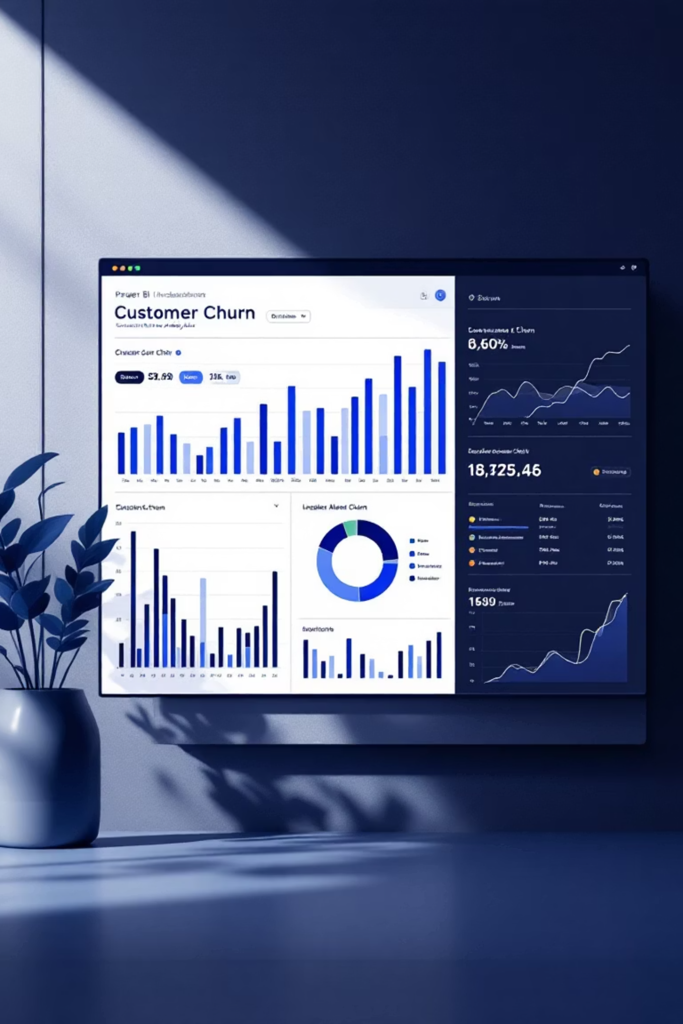
Customer Churn Analysis Dashboard
An Interactive Business Intelligence Report for Strategic Customer Retention
Prepared by: Syed Ameen Ahmed
Page - 1

Slide 2



The Business Problem: Stemming the Tide of Churn
Revenue Erosion
Stunted Growth
Understanding "Why"
Customer churn directly translates to significant revenue loss, impacting financial stability and growth projections.
High churn rates hinder long-term business expansion and market share growth, making sustainable progress challenging.
Identifying who is leaving and why they are churning is paramount for developing effective retention strategies.
Key Business Questions:
What is the current churn level across different segments?
Which customer segments exhibit the highest churn rates?
What underlying factors and behaviors influence customer churn?
Page - 2

Slide 3

Strategic Objectives: Navigating Towards Retention
Analyze Churn Behavior
Identify Driving Factors
Deep dive into customer churn patterns and trends to understand the dynamics at play.
Pinpoint the root causes and specific elements that contribute to customer attrition.
Support Retention Decisions
Deliver Interactive Insights
Provide data-backed insights to inform and guide effective customer retention strategies.
Equip stakeholders with an intuitive, interactive tool for ongoing analysis and decision-making.
Page - 3

Slide 4
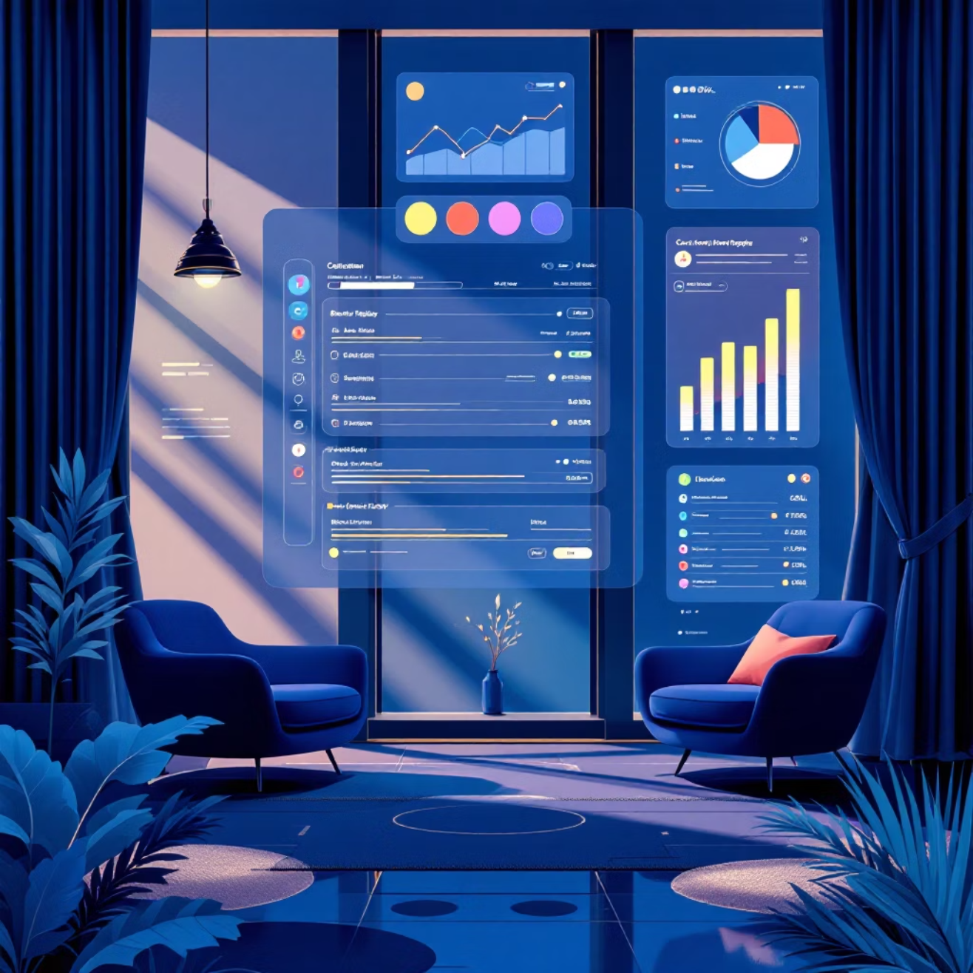

Dataset Overview: A Glimpse into Our Customer Base
Our analysis is built upon a comprehensive dataset of 7,043 customers, providing a rich foundation for understanding churn.
Key Data Fields Explored:
Demographics: Gender, Partner status, Dependents
Contract & Payment: Contract type, Payment method, Billing preferences
Internet Services: Type of internet service, Online security, Tech support
Usage & Charges: Customer tenure, Monthly charges, Total charges
Churn Status: Clearly indicating whether a customer has churned or not
Dataset Source: Customer Churn (Kaggle)
Page - 4

Slide 5



Tools & KPIs: The Engine of Our Analysis
Power BI
DAX
Data Cleaning & Modeling
Utilized for interactive dashboard creation and data visualization.
Data Analysis Expressions for advanced calculations and metrics.
Ensuring data accuracy and structuring for optimal performance.
7,043
1,869
26.5%
$64.76
Total Customers
Churned Customers
Churn Rate
Avg Monthly Charges
The overall customer base analyzed in the dashboard.
The number of customers who have discontinued their services.
Percentage of customers lost over a specific period.
The average billing amount per customer per month.
$45.8M
Total Revenue
Aggregate revenue generated from the entire customer base.
Page - 5

Slide 6

Dashboard Overview: Your Interactive Churn Insight Hub
This Power BI dashboard provides a dynamic and intuitive interface for exploring customer churn data.
KPI Summary Cards
At-a-glance metrics for total customers, churned customers, churn rate, average monthly charges, and total revenue.
Churn Distribution Visuals
Graphical representations illustrating how churn is spread across various customer attributes.
Customer Segmentation
Detailed breakdowns of churn rates by demographics, services, and contract types.
Tenure-Based Trend Analysis
Visualizations showing how churn varies with customer longevity.
Interactive Slicers
Enable dynamic filtering to drill down into specific segments and periods.
Page - 6

Slide 7

Key Churn Analysis Insights
Contract Type Matters
Customers on month-to-month contracts exhibit significantly higher churn rates compared to those with longer-term commitments. This suggests a lack of loyalty or satisfaction incentives for short-term users.
Payment Method Impact
Users relying on electronic check payments show a higher propensity to churn. This could indicate a correlation with digital-first, less committed customer segments.
Service Dependency
Customers utilizing fiber optic internet service contribute disproportionately to overall churn. Further investigation is needed to understand specific issues related to this service type.
Billing Preference Influence
Subscribers with paperless billing also show an increased churn tendency. This might indicate a segment that is more tech-savvy but less engaged with traditional loyalty drivers.
Page - 7

Slide 8
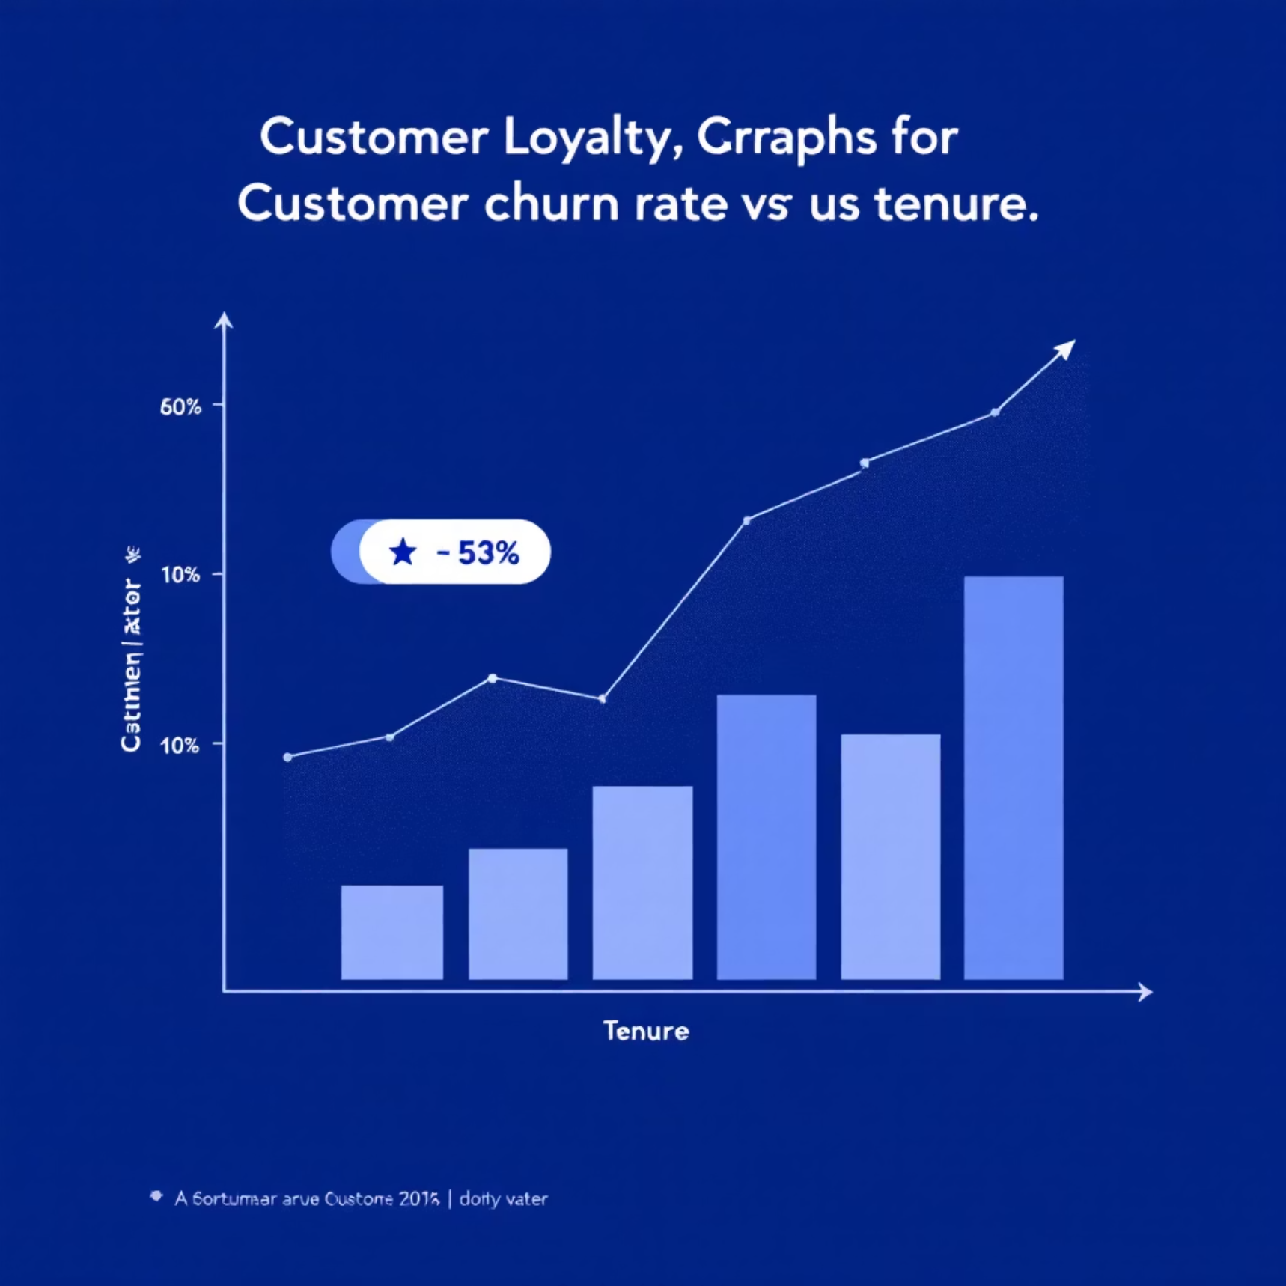
Tenure & Customer Behavior: The Loyalty Landscape
Low Tenure, High Churn
A pronounced trend of higher churn is observed among customers in their initial months of service. This critical period is key for engagement.
Early Support Needs
Technical support tickets are notably more frequent during the early tenure phase, indicating potential onboarding issues or initial service frustrations.
Long-Term Retention
Conversely, customers with extended tenure demonstrate significantly better retention rates, highlighting the value of nurturing long-standing relationships.
Page - 8
Understanding these tenure-based dynamics is vital for tailoring interventions at different stages of the customer lifecycle.

Slide 9




Business Impact: Quantifying the Cost of Churn
Informed Decisions
1
Empowers leadership with actionable data for strategic planning.
Prioritize Retention
2
Helps focus efforts and resources on the most impactful retention initiatives.
Identify High-Risk Segments
3
Pinpoints vulnerable customer groups for proactive engagement.
Revenue Loss Mitigation
4
Directly addresses the financial drain caused by customer attrition.
Reducing churn is not just about saving customers; it's about safeguarding revenue, optimizing resources, and ensuring sustainable business growth.
Page - 9

Slide 10








Conclusion: Empowering Future Growth
The Customer Churn Analysis Dashboard is more than just a report; it's a strategic asset for proactive customer management.
Actionable Insights
Interactive Exploration
Delivers clear, data-driven understanding of churn behavior.
Enables deep-dive analysis into specific customer segments and factors.
Revenue & Retention
Power BI Effectiveness
Directly supports strategies for increased customer retention and sustained revenue growth.
Showcases the robust capabilities of Power BI for business intelligence.
By leveraging these insights, we can transform customer churn from a challenge into an opportunity for strategic customer engagement and business success.
Page - 10

